Slide 1
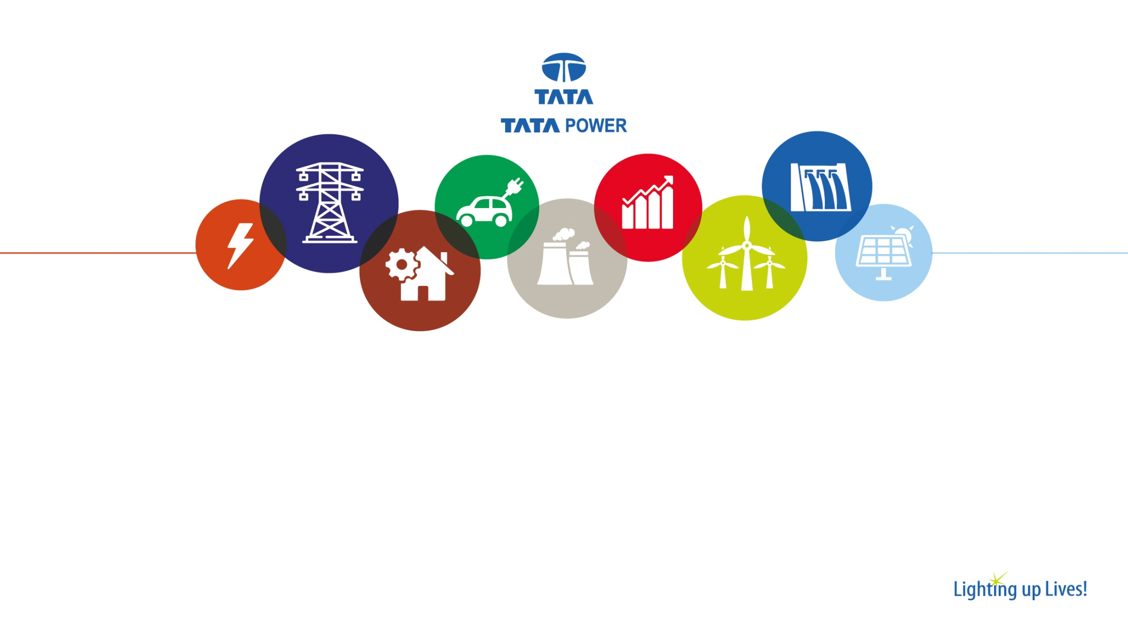
Proposal
for
Determination of value of “X” for computation of the deviation (in %) for wind and solar (WS) Sellers from 01.04.2026 onwards under DSM , Regulations, 2024

Slide 2
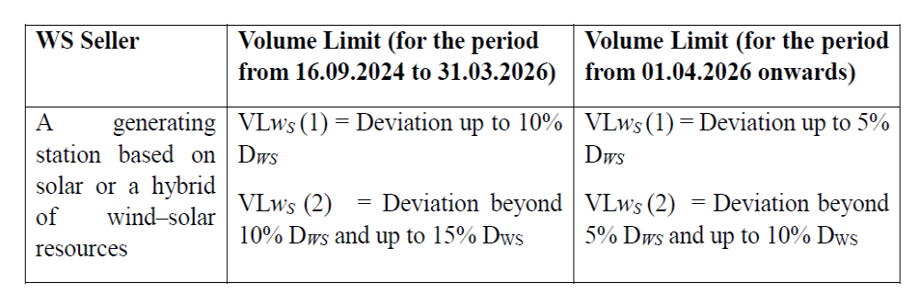
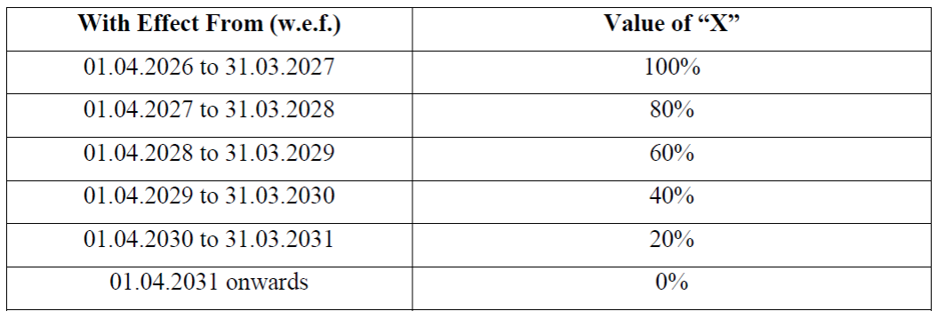
Proposals mentioned in the draft
Reduction in Volume Limits w.e.f. 01. 04.2026 –
Solar/Hybrid – 10% to 5%
Wind – 15% to 10%
Change in calculation of deviation (%) formula:
Existing = (Actual injection -Scheduled generation)/AVC
Proposed = (Actual injection -Scheduled generation)/(X.AVC +(100-X)*Scheduled generation)
No payment for over injection during grid frequency over 50.05 HZ
At par with GS seller –
With immediate effect: New projects with tendering or bid submission date on or after 01.04.2026
From 01.04.2031: Existing wind, solar and hybrid projects

Slide 3
Clarifications Sought
At par with GS seller – Currently General seller is defined under three categories
General seller other than ROR and MSW : permissible volume limits is 10% or 100 MW and linked with frequency band
ROR : Permissible volume limit is 15% or 150 MW and delinked from frequency
MSW: Permissible volume limit is 20% and delinked from frequency
Whether another category of GS under Solar/Hybrid as one segment and Wind as separate segment shall be created. Also needs further clarification on Frequency.
Treatment of Aggregation of New sites with existing operating sites – As per the current proposal, NEW projects are considered at par with General sellers and existing projects shall follow the X factor from 100 in FY27 to Zero in FY32. Therefore, clarification is sought from the commission, whether aggregation of existing and new projects at a PSS is permitted. In case it is permitted, then which DSM methodology shall be adopted.
X factor is zero in FY32 – X factor is considered to be zero in FY32, i.e. the denominator is equal to schedule, in that case if generation happens from the plant when schedule is zero, how the treatment will happen.

Slide 4
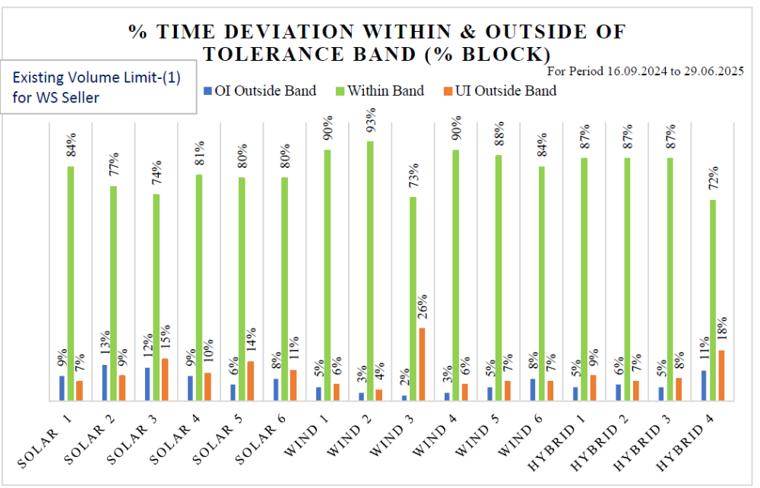
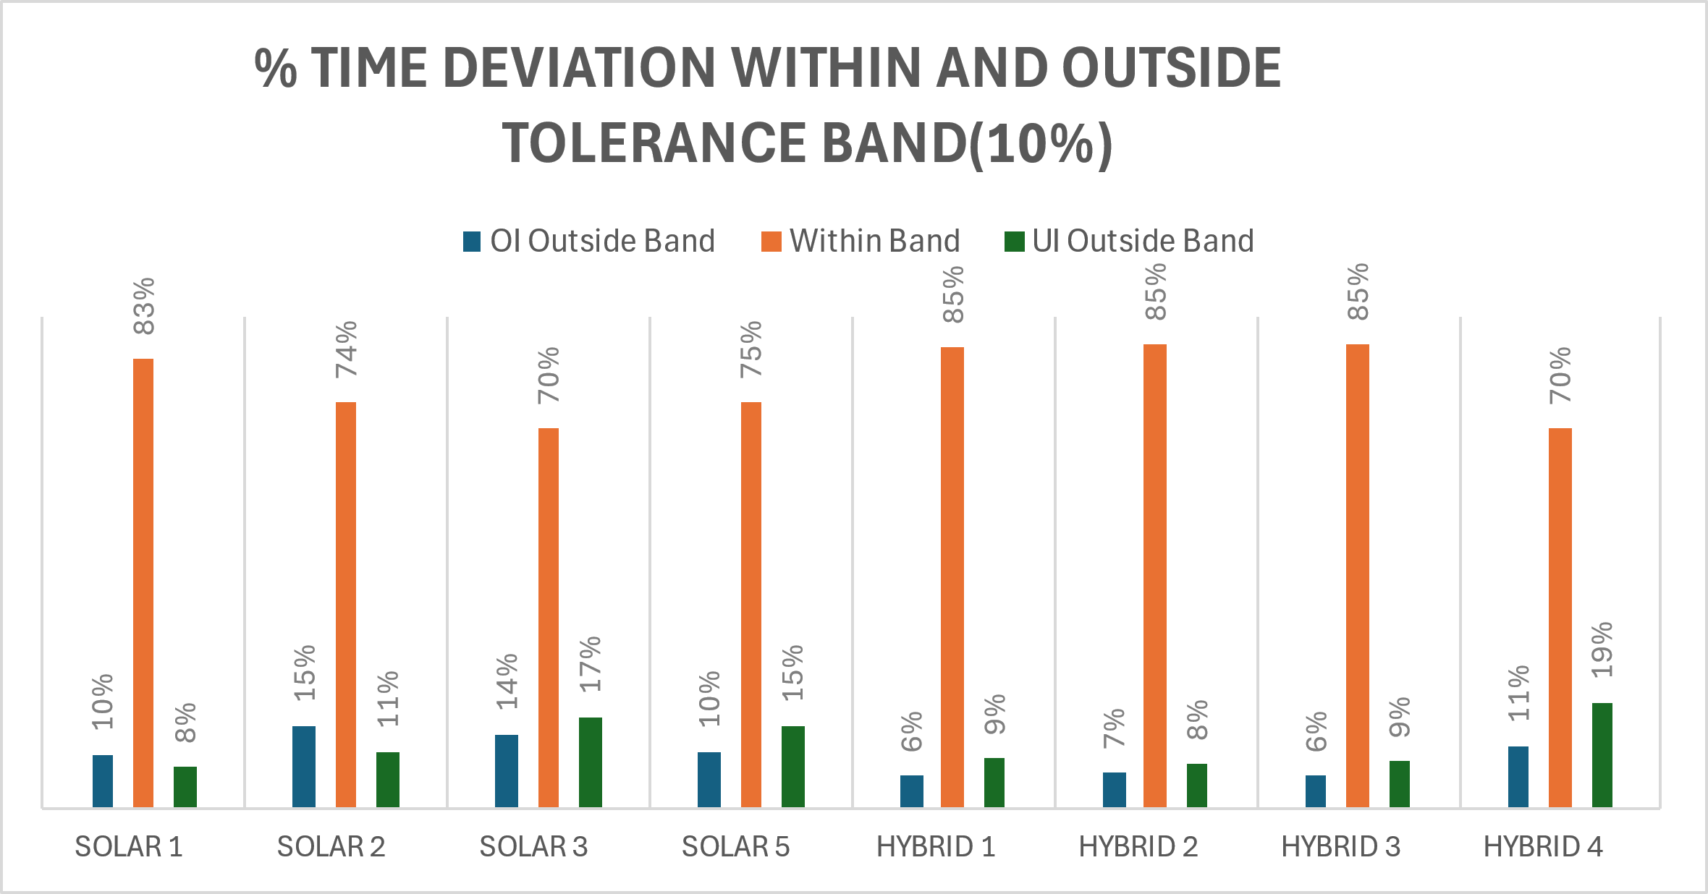
Observations
The study represented in the proposal is done for the period 16.09.2024 to 29.06.2025, which excludes the two crucial month of the monsoon.
Considering this period (i.e. from 16.09.2024 to 31.08.2025, the results are as follows
Forecasting Accuracies

Slide 5
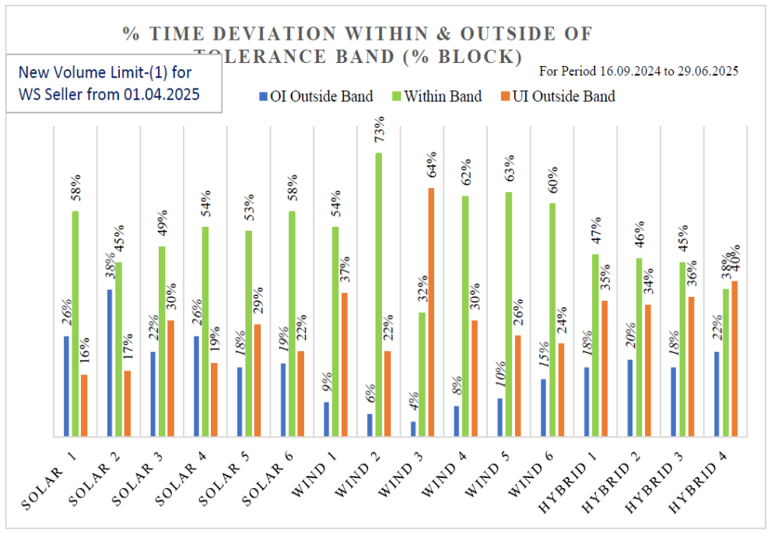
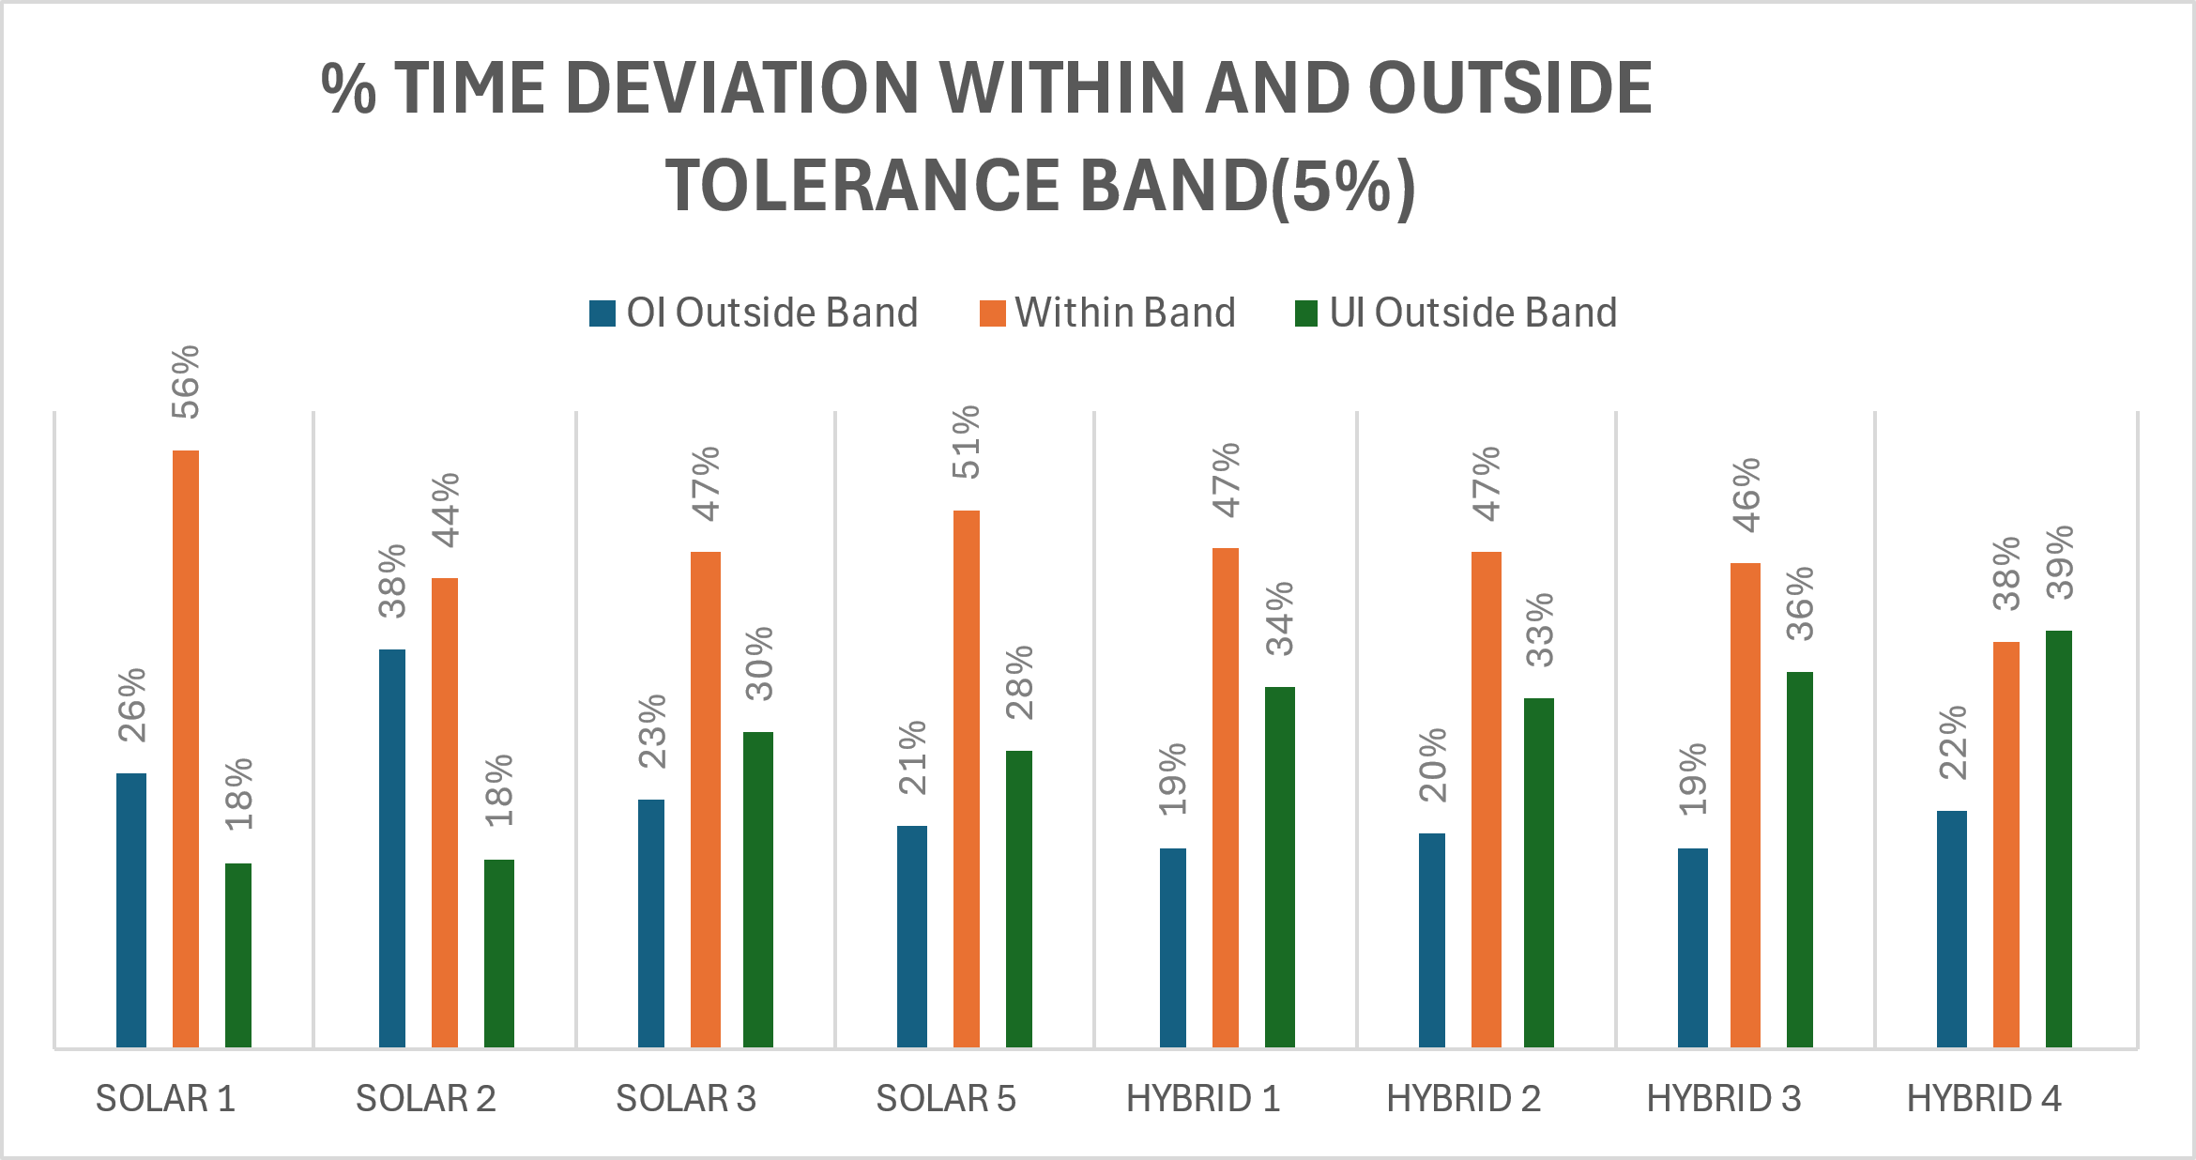
Observations
With New Volume Limits

Slide 6
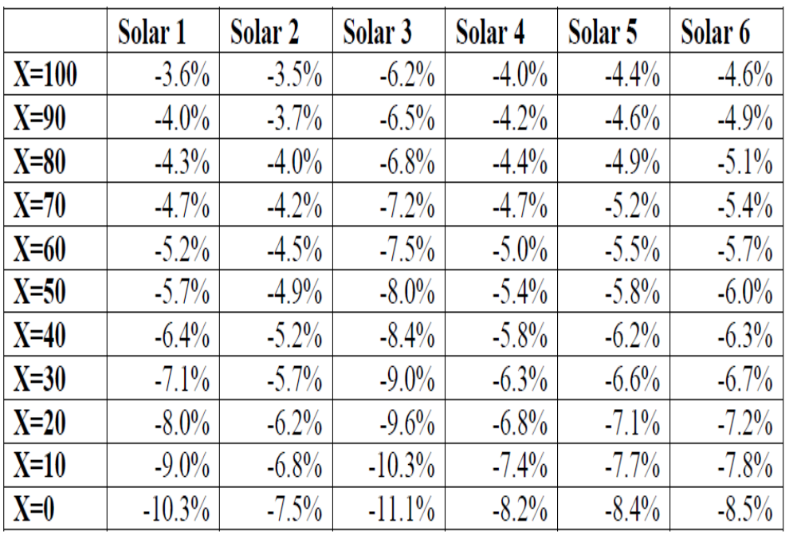
Observations
% Loss w.r.t Contract Rate
X-Factor | Solar 1 | Solar 2 | Solar 3 | Solar 5
X=100 | 3.95% | 4.01% | 6.71% | 6.20%
X=90 | 4.32% | 4.27% | 7.05% | 6.53%
X=80 | 4.74% | 4.54% | 7.42% | 6.89%
X=70 | 5.21% | 4.85% | 7.82% | 7.28%
X=60 | 5.75% | 5.19% | 8.25% | 7.71%
X=50 | 6.37% | 5.57% | 8.73% | 8.18%
X=40 | 7.09% | 6.00% | 9.27% | 8.70%
X=30 | 7.92% | 6.49% | 9.87% | 9.29%
X=20 | 8.89% | 7.05% | 10.54% | 9.96%
X=10 | 10.06% | 7.72% | 11.30% | 10.74%
X=0 | 11.46% | 8.50% | 12.22% | 11.67%
As per Draft – 16-09-2024 to 29-06-2025
Considering the period -16-09-2024 to 31-08-2025

Slide 7
Measure required for improvement in F&S accuracies on solar prospective
Improvement in Weather parameters of the project (Cloud movement, Fog)
Use of Advanced Forecasting & Scheduling software integrated with AI and ML techniques
Integration of Energy Storage System
Aggregation at Regional level
Revisions to be made effective at the earliest (preferably from 4th time block onwards)

Slide 8
Suggestions and Recommendations
Allow Company- Wide Aggregation of all Wind/solar/hybrid plants in a region
Allow QCA aggregation of WS sellers at the region level with a cap on deviation limits (500 MW)
Use of BESS to be permitted to accommodate the deviations of the plants across the region company level aggregation
WS sellers should be allowed to procure the power from market to compensate the deviations
Schedule revisions for WS sellers to be made effective from 4th time block onwards
WS sellers supporting the grid during the frequency over 50.05 HZ shall be compensated
Grandfathering for existing projects (the proposed changes such as change in x-factor, no payment during frequency above 50.05 HZ etc. should not be made applicable for the existing projects as these projects have not factored the suggested changes during the bidding stage).

Slide 9
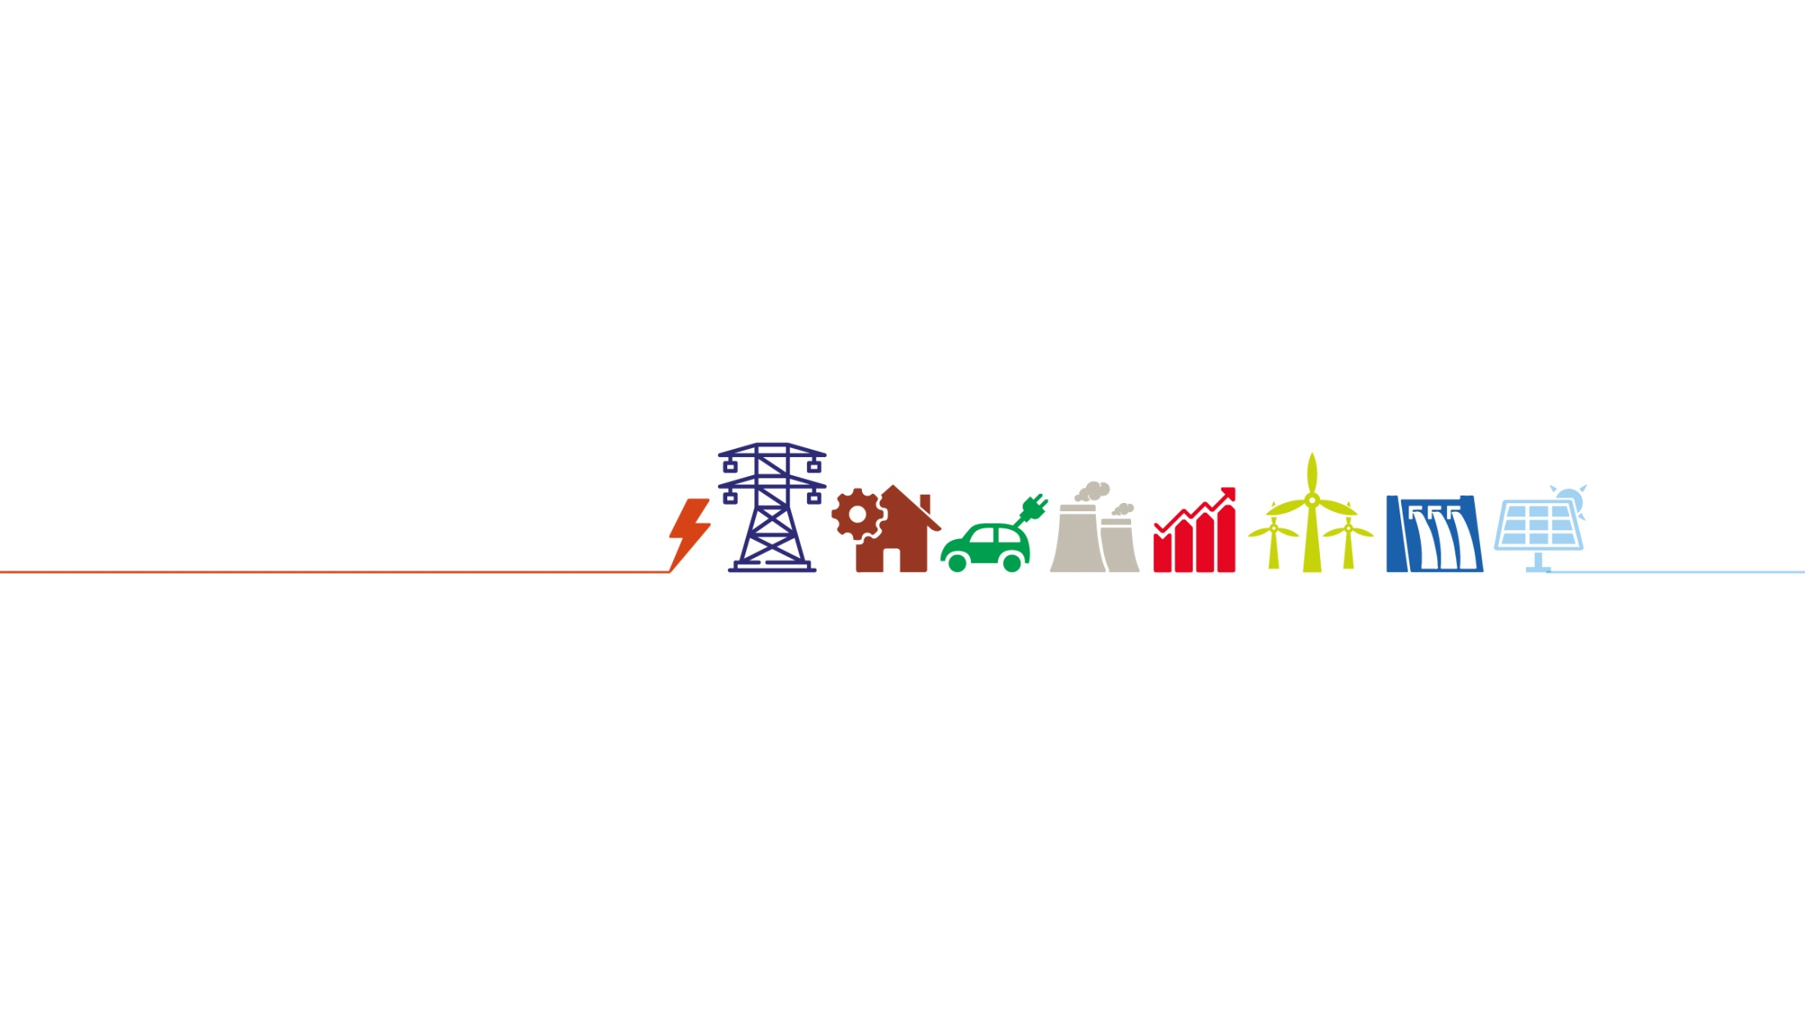
Disclaimer: The contents of this presentation are private & confidential. Please do not duplicate, circulate or distribute without prior permission.
Thank You!
Website: www.tatapower.com
Private and Confidential

